Slide 1
< risk biased A* Pathfinding algorithm >
<Zacharius Sousa>
Supervisor: saito yuichi

Slide 2
Starting research
Blind intersections are intersections where traffic on the crossing street isn’t visible for 30m in either direction, during the last 30m before the intersection as objects/buildings block the view.
This is dangerous as cyclists and other vehicles can dart out rapidly giving the driver very little time to react and or perform an evasive maneuver.

Slide 3
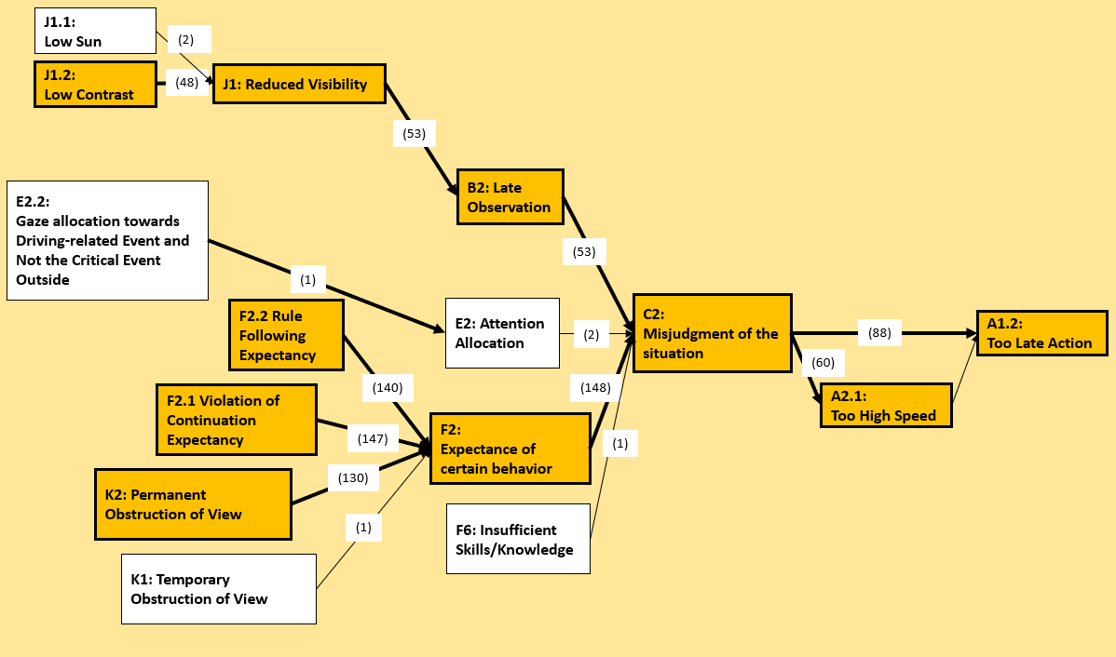
Initial Research (148 cases)

Slide 4
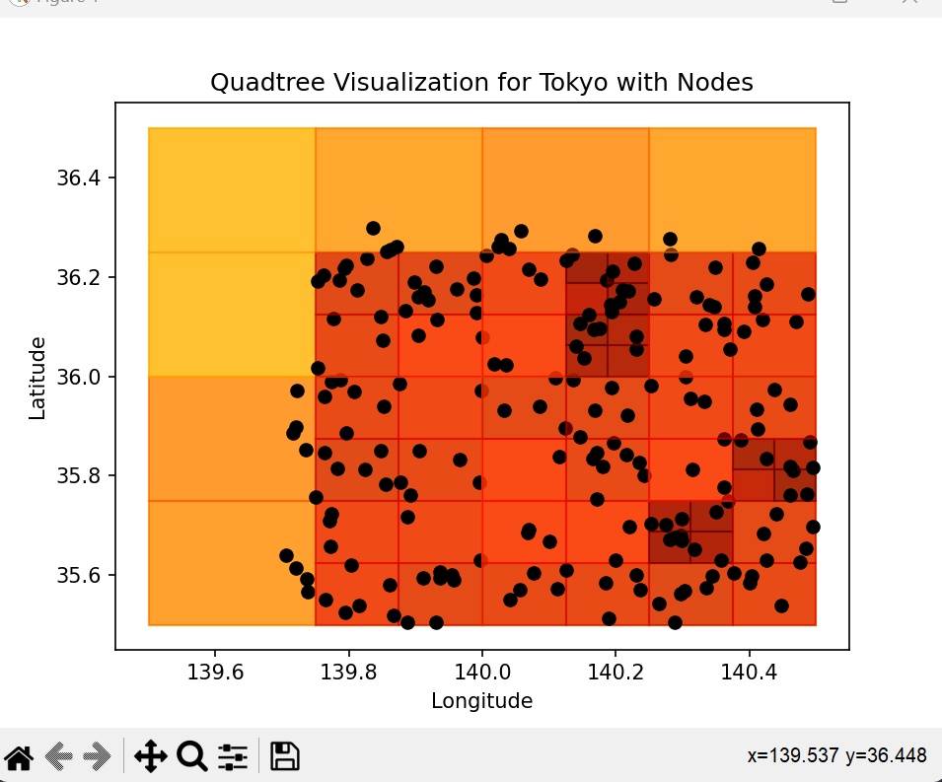
Finding problem intersections
Quadtrees work by dividing a Quad or square into 4 smaller quads when a certain condition is met in this case # of accidents that fall within them.
Accident data was obtained from the Japanese National Police Agency

Slide 5
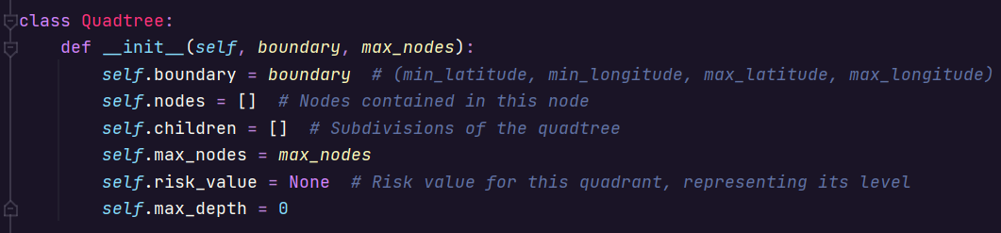
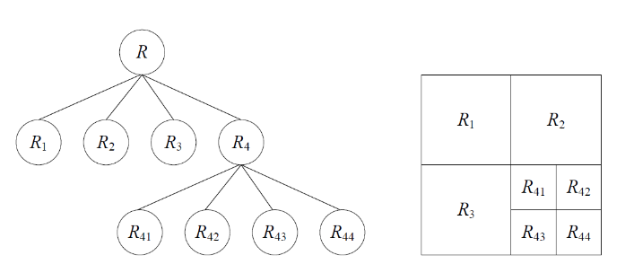
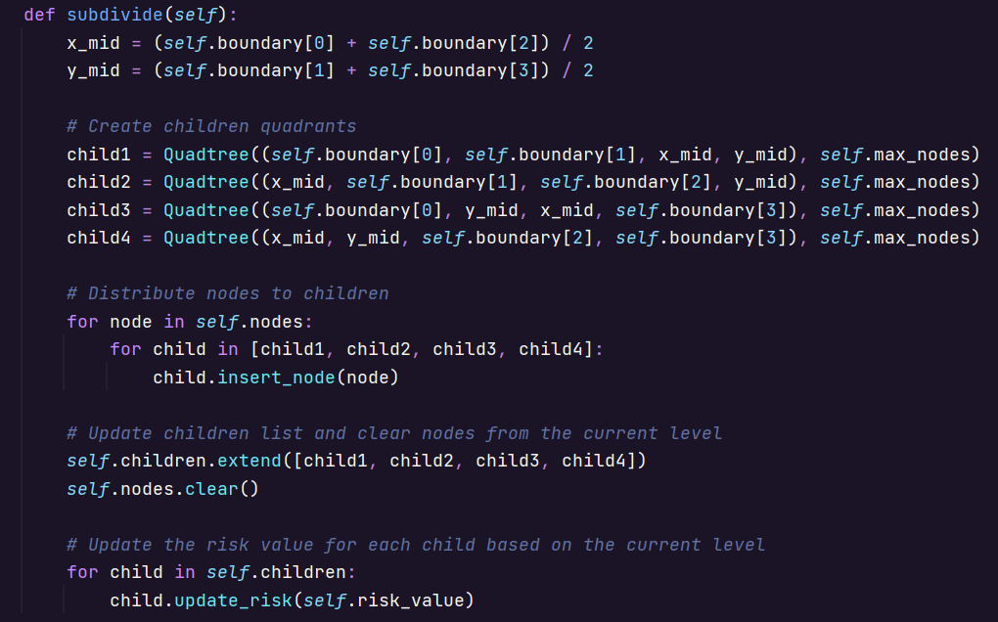
Quadtree process

Slide 6
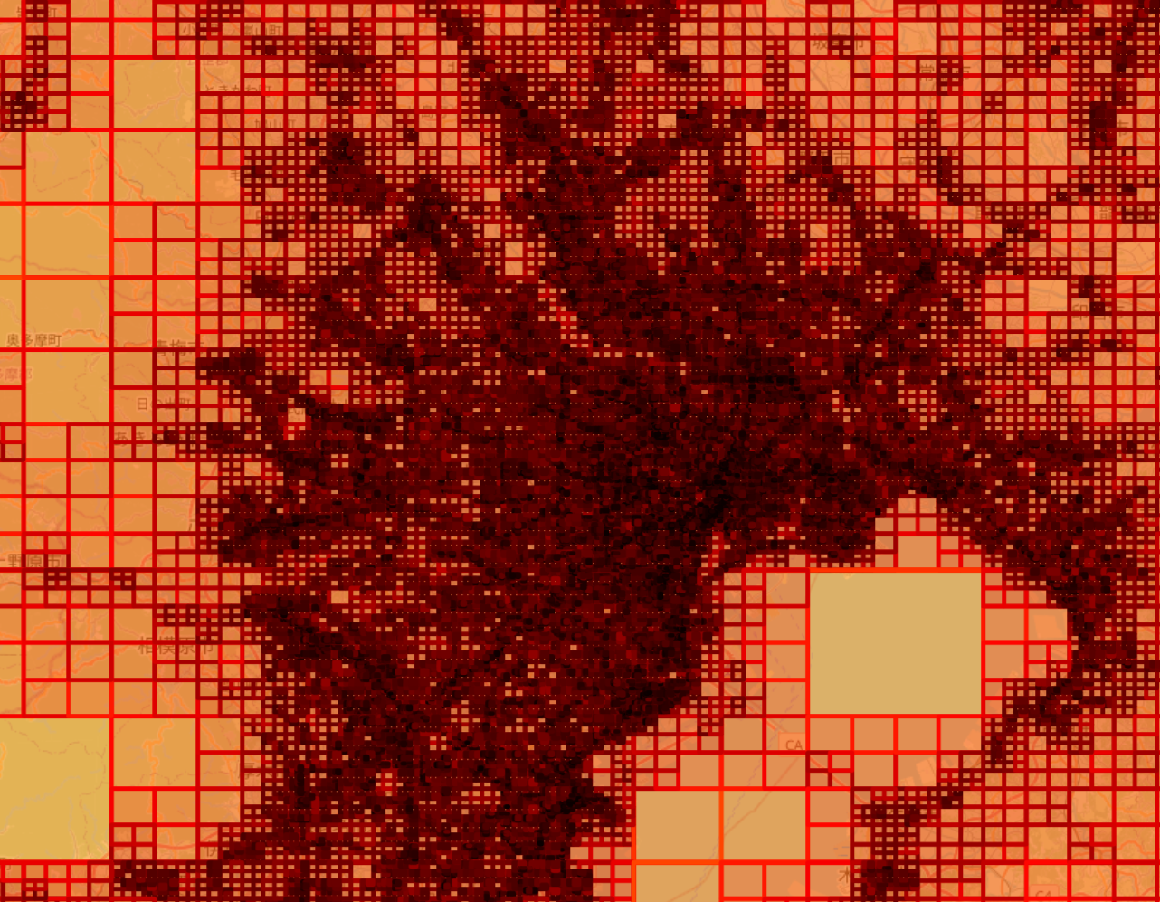
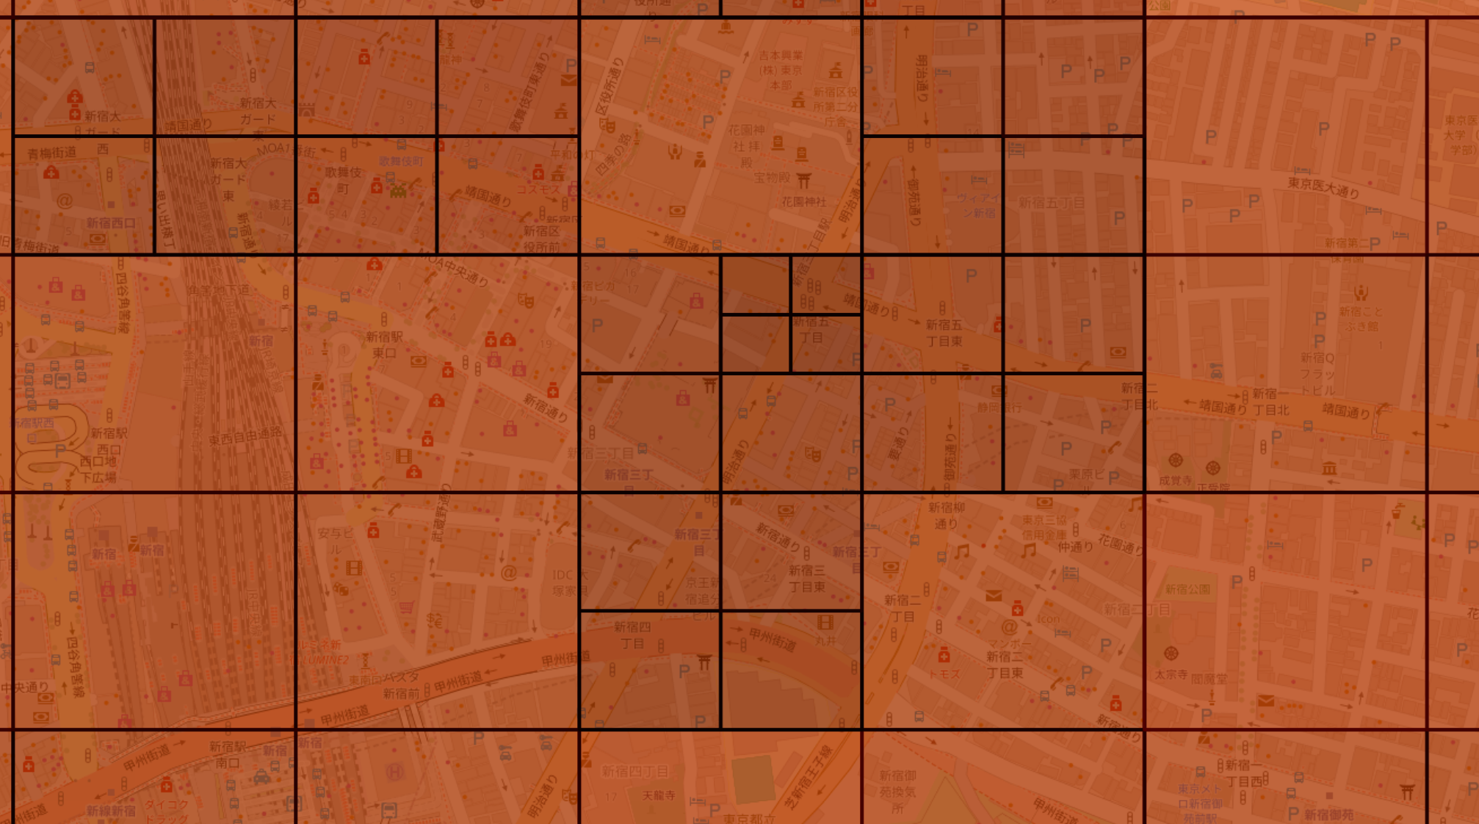
Real world visualization tokyo

Slide 7
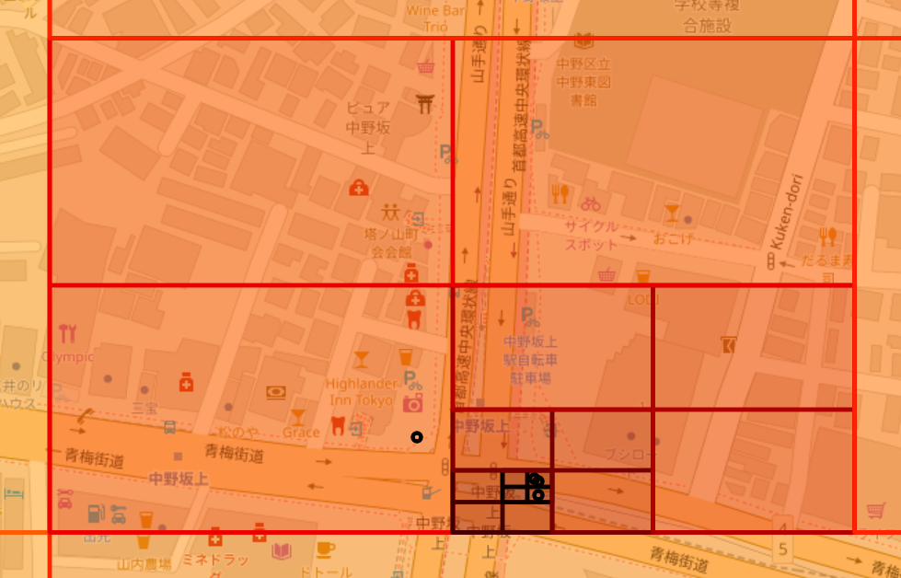
Findings from visualization
Create a path finding algorithm that can use a the risk of each quad to calculate a safe route for drivers.
Although risk values of a particular quad may bleed into neighboring quads

Slide 8
The Problem
In 2022 alone approximately 300.8 thousand road traffic accidents were recorded in Japan, down from about 726 thousand in 2010. (Arba 2023)
The number of fatal traffic accidents per 100,000 elderly people with driver's licenses came to 5.7, more than double the 2.5 per 100,000 drivers under the age of 75. (JIJI 2023)
As Japan is a densely populated country, roads tend to have much more pedestrian traffic compared to western countries also, many intersections are occluded by buildings

Slide 9
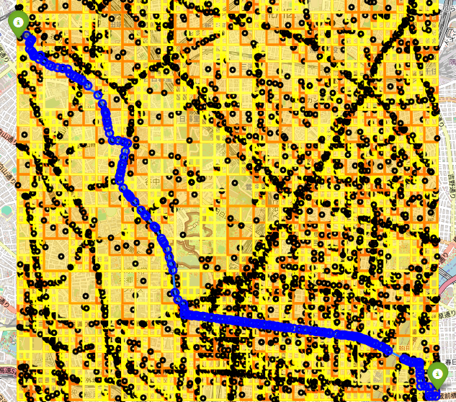
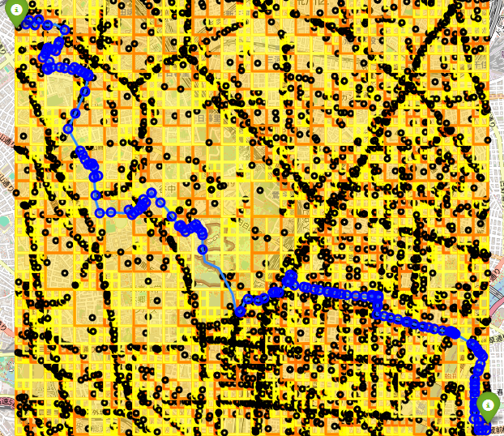
First implementation Shortest path vs quadTree safe path

Slide 10
first path finding algorithm remarks
The pathfinding algorithm worked as intended and did bias towards routes that had a smaller accident history.
As traffic data on a given road isn’t publicly available, its difficult to discern if the “safer” route had fewer accidents per motorist.
Dijkstra’s algorithm was used which is easier to implement but slower at finding the optimal path versus A* algorithm.
Overall, it acted as a proof of concept that could be refined further.

Slide 11
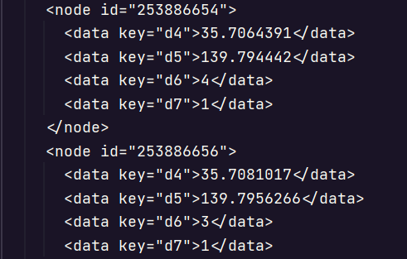
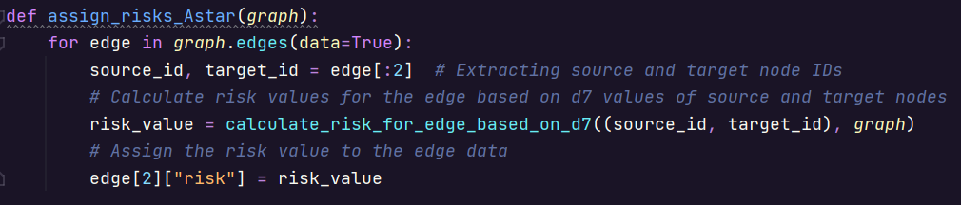
Design implementations final revision
Stop using quadtree data as it is not as precise as possible.
Assigned risks to nodes (specific intersections) before runtime which allowed for much more precise pathfinding as well as speeding up the program significantly.

Slide 12
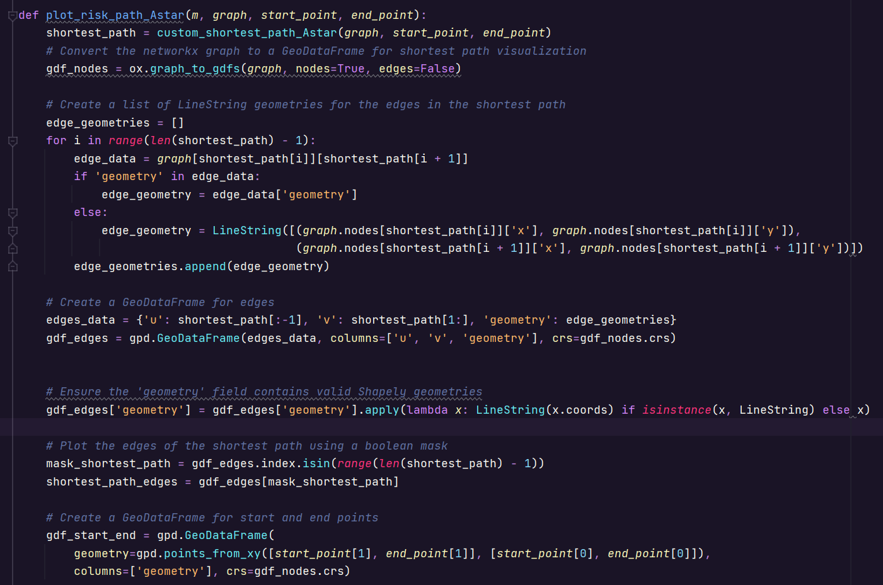
Final iteration Code Snippet

Slide 13
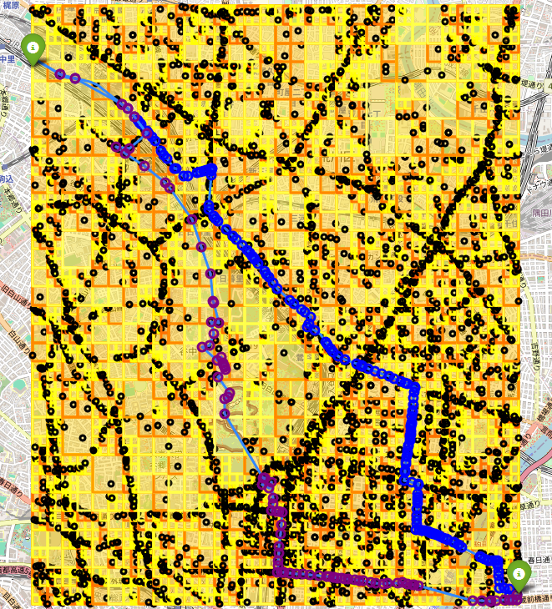
Final iteration visualized
The A* algorithm works by weighing the distance between nodes or intersections. Slowly making it way towards the end point, choosing the most efficient path.
This particular model also takes the risk value of each node into account when deciding the optimal path, which is what makes it different.

Slide 14
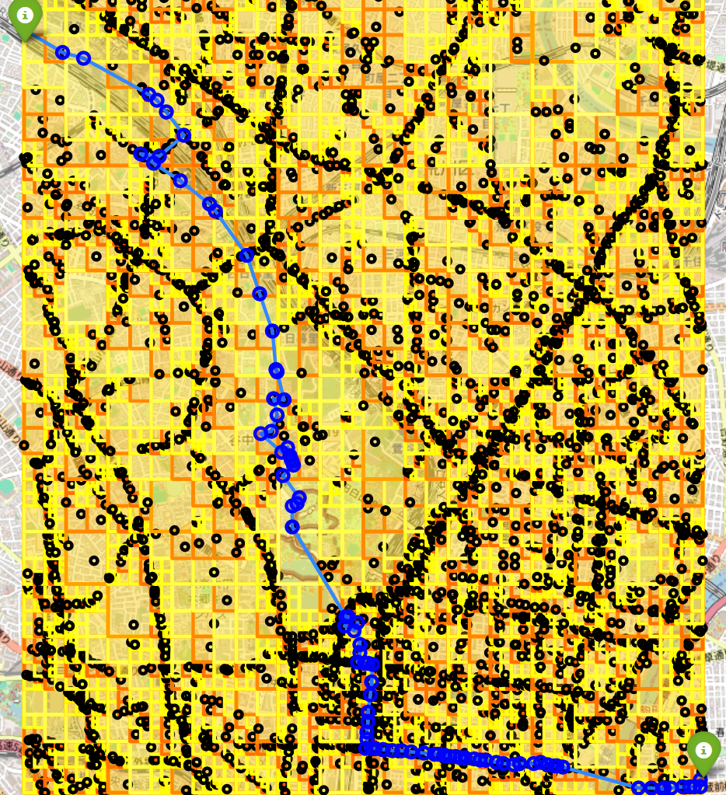
Dijkstra vs A*

Slide 15
Final Result
The program worked as intended although some changes I would like to make would be.
Obtain traffic data to weigh accidents vs traffic for more accurate risk prediction.
Force the algorithm to make fewer turns as elderly drivers may have a hard time paying attention to more factors.

Slide 16
Citations
(Arba 2023) Alexander Arba, Japan: number of traffic accidents 2022, https://www.statista.com/statistics/661958/japan-road-traffic-accidents/, Statista
(JIJI 2023) JIJI, Japan's elderly drivers caused 379 deadly crashes in 2022, https://www.japantimes.co.jp/news/2023/03/02/national/crime-legal/japan-elderly-drivers-record-fatalities/, The Japan Times

